Slide 1
Capstone Project
NYC TAXI TRIP TIME PREDICTION
By: Dharmesh Patel

Slide 2
Contents
Problem Statement
Introduction
Data Summary
Data Analysis
Challenges
Conclusion

Slide 3
Data Summary
The dataset consists of 11 columns and around 1.5 Million records
The dataset consists of 6 months of data of year 2016.
Main Features:
1. Vendor ID
2. Pickup and Dropoff Datetime
3. Passenger Count
4. Pickup and Dropoff Latitude and Longitudes
5. Store and forward flag
6. Trip Duration

Slide 4
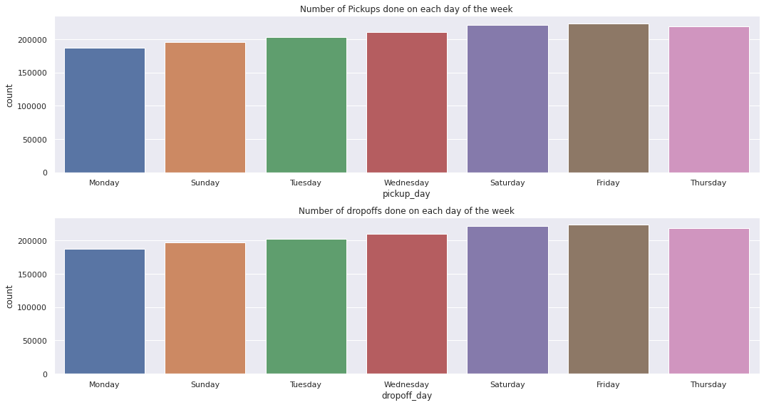
EDA

Slide 5
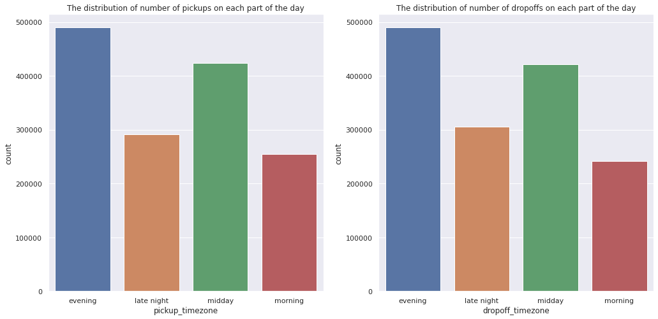
EDA

Slide 6
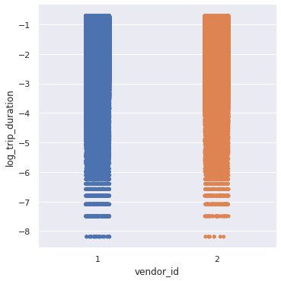
EDA

Slide 7


Linear Regression
TRAIN SET | TEST SET

Slide 8


Decision Tree
TRAIN SET | TEST SET

Slide 9
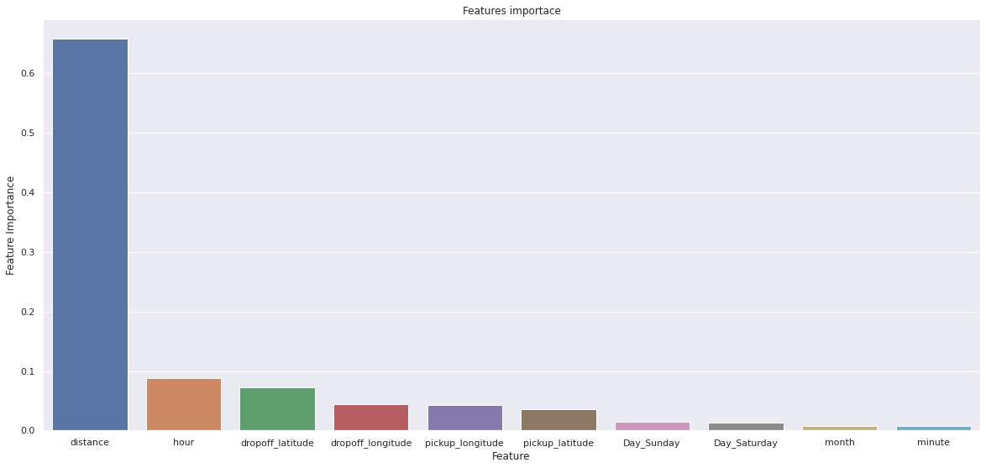
Decision tree important parameter

Slide 10


Ridge Regression
TRAIN SET | TEST SET

Slide 11


XGBoost
TRAIN SET | TEST SET

Slide 12
XGBoost Important Parameter

Slide 13



Gradient Boosting Regressor
TRAIN SET | TEST SET

Slide 14

Gradient Boosting Important Parameter

Slide 15



Random Forest
TRAIN SET | TEST SET

Slide 16
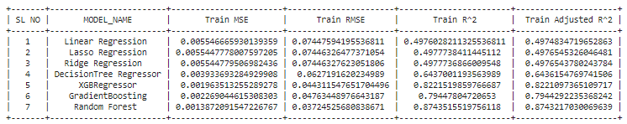
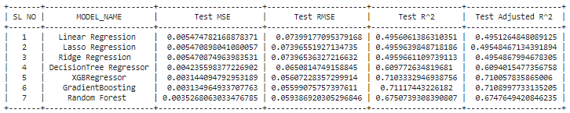
Final Comparison

Slide 17
Challenges
Handling Large Dataset.
Feature Engineering.
Computation Time.
Optimising the Model.

Slide 18
Conclusion
In this project, we tried to predict the trip duration of a taxi in NYC.
We are mostly concerned with the information of pick up latitude and longitude and drop off latitude and longitude, to get the distance of the trip.
Gradient Boosting will be the best model to predict the trip duration for a particular taxi.

Slide 19
Thank You

